Slide 1




Client Presentation #2
Using Analytics to
Predict Title Defects & Value Risks
PRESENTED BY
THE ALEAT RS
Fanya Weng

Slide 2









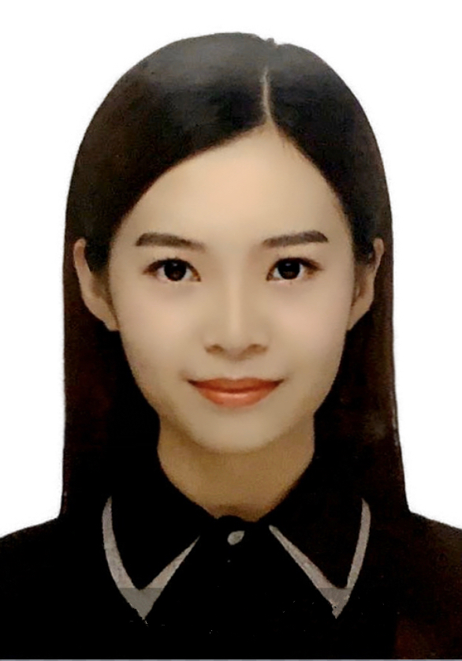
The Aleators
Technical Analyst
Team Leader
Xueyi Wu
Xinzhu Liu
Yujie Xiang
Tong Qi
Quality Control Analyst
Visual Analyst
Minqian Jiang
Yi Xing
Yimin Wang
Fanya Weng
Wenqian Liu
2

Slide 3





Agenda
Business & Project Overview
Modeling Process
Research Methodologies
Results & Recommendations
Success Criteria
Insurance Product
3

Slide 4




Business Overview
Industry Review
The title insurance industry evolves to a highly concentrated market
The consumers find it difficult to compare title insurance due to unfamiliarity
Innovations
Fintech is transforming the industry
Title insurance companies embrace two new business models
As the industry become more price competitive, the insurance premiums will favor the consumer
Source American Land Title Association (2017)
U.S. Title Insurance Industry Market Share by Company, 2017
Business & Project Overview | Methodologies | Success Criteria | Modeling | Results | Insurance Product
4

Slide 5
Project Overview
Mission
Make real estate simple, affordable, and effortless for everyone involved.
Business
Question
How to improve the efficiency of title insurance assessment?
01
Solution
Using Analytics to Predict Title Defects and Value Risks
Claims on Insurance
Goals
Build predictive model
Develop a title insurance product on top of our model
02
Lawsuits
Benefits
Improve underwriting decisions
Increase operational efficiency
Lis Pendens
03
Business & Project Overview | Methodologies | Success Criteria | Modeling | Results | Insurance Product
5

Slide 6
Research Question and Hypothesis
Is the quality of this dataset good enough to predict title defects?
Research Question 1
Which variables are most important to predict title defects?
Research Question 2
The dataset is not in good quality.
There is no significant correlation between Total Market Value and Title Defects.
Null Hypothesis
Business & Project Overview | Methodologies | Success Criteria | Modeling | Results | Insurance Product
6

Slide 7
What We Did
 | June 26 | July 3 | July 10 | July 17 | July 24 | July 31 | August 7
Project Planning
Data Cleaning
Feature Selection
Modeling
Evaluation & Visualization
Insurance Product Design
Review & Improvements
1
Analyzed and visualized the correlations among variables
2
Used machine learning techniques to select important features
3
Developed highly accurate models to predict title defects
4
Utilized results to design a new insurance product
5
Generated actionable recommendations for Spruce
Business & Project Overview | Methodologies | Success Criteria | Modeling | Results | Insurance Product
7

Slide 8

Data Description
500,250 Observations, 52 Variables
Data accounts 0.36% title defects of whole dataset
Target Variable
Attributes of Property Itself
Attributes of Household Region
Existing & Predictive Defects
Title Defective Indicator
Entity Structure
Demographics
Defective Records
Market Value
House Price
Predictive Score
History
Business & Project Overview | Methodologies | Success Criteria | Modeling | Results | Insurance Product
8

Slide 9


Feature Selection
Filter Methods
Embedded Methods
Wrapper Methods
May fail to find the best subset as they do not involve training the models
May require
lengthy running time
Lasso
Business & Project Overview | Methodologies | Success Criteria | Modeling | Results | Insurance Product
9

Slide 10
Lasso Feature Selection
Function: SelectFromModel()
selected_feat
Result: 16 out of 19 features were selected by Lasso method.
StatusOwnerOccupiedFlag
X_PERC_CDPD60
X_PERC_CForeclosure
X_PERC_CDerogatory
X_PERC_CBankruptcy
X_PERC_MDPD60
TaxAssessedValueTotal
TaxMarketValueTotal
dr_MktValueToIncome
dr_Condo_Ind
dr_Ownership_Period
dr_House_Age
dr_Value_Change
E_MEDHHINC
X_PERC_MDerogatory
X_PERC_MBankruptcy
X_Bankruptcy_Index
X_Risk_Score
X_Vantage_Score
Business & Project Overview | Methodologies | Success Criteria | Modeling | Results | Insurance Product
10

Slide 11
Feature Selection
Function: sfs() – Step Forward Selection
selected_feat
Result: To keep up with Lasso method, select 16 out of 19 features.
StatusOwnerOccupiedFlag
X_PERC_CDPD60
X_PERC_CForeclosure
X_PERC_CDerogatory
X_PERC_CBankruptcy
X_PERC_MDPD60
TaxAssessedValueTotal
TaxMarketValueTotal
dr_MktValueToIncome
dr_Condo_Ind
dr_Ownership_Period
dr_House_Age
dr_Value_Change
E_MEDHHINC
X_PERC_MDerogatory
X_PERC_MBankruptcy
X_Bankruptcy_Index
X_Risk_Score
X_Vantage_Score
Business & Project Overview | Methodologies | Success Criteria | Modeling | Results | Insurance Product
11
Notes:
This is the note

Slide 12

Data Cleaning
Step One
Step Two
Issue
Solution
Transform Data
Deal Missing Values
Too many NA Values
Impute mean values
Impute with mean using SimpleImputer
There are too many rows with NA so dropping them all would not be ideal
.
We have imputed mean values of each column to replace NA values
Change dr_Value_Change from INC, NC, DEC to 1,0,-1
Business & Project Overview | Methodologies | Success Criteria | Modeling | Results | Insurance Product
12

Slide 13


Data Modeling
1
Logistic Regression
Easy Implementation
High Efficiency
Binary
Outcome
Classifier
Assumption of Linearity
Further Interpretation
defect = 1
non-defect = 0
2
Decision Tree/ Random Forests
Less Data Preparation
Visualization
Overfitting
Heuristics (Greedy Algorithms)
Business & Project Overview | Methodologies | Success Criteria | Modeling | Results | Insurance Product
13

Slide 14
Data Modeling
3
KNN
Simple Algorithm
Dimensionality
Binary
Outcome
Classifier
Assumption of Linearity
Further Interpretation
defect = 1
non-defect = 0
4
XGBoost
Shorter Running time
Parallelizable
Converts Categorical Data into One
Hot Encoding
Business & Project Overview | Methodologies | Success Criteria | Modeling | Results | Insurance Product
14

Slide 15

Success Criteria
Highest AUC
Meet Spruce's expectations
(Costs, scopes, benefits, etc.)
Quality Data Set
Probability of title defect for each single observation
Satisfactory results for stakeholders
Business & Project Overview | Methodologies | Success Criteria | Modeling | Results | Insurance Product
15

Slide 16


Dealing with Imbalance Data
⚠️ LOW RMSE → Data Imbalancing
Method 1
Resampling data using SMOTETomek (All models except XGBoost)
Method 2
Dealing with imbalance by adjusting scale_pos_weight (XGBoost)
scale_pos_weight = total_negative_examples / total_positive_examples
Business & Project Overview | Methodologies | Success Criteria | Modeling | Results | Insurance Product
16

Slide 17

Model Fitting
Step 1
Train / Test Split
Split the balanced data into train set and test set
-> X_train, X_test, y_train, y_test
Standardize the X_train
Step 2
Fit & Predict
Fit all the models on X_train and y_train
Generate predicted results on X_test
Step 4
Parameter Tuning
Adjust the model parameters according to the results to reach the optimal status
Step 3
Compute Metrics
Obtain Accuracy, RMSE, Precision, Recall, AUC, Confusion Matrix to evaluate each model
Business & Project Overview | Methodologies | Success Criteria | Modeling | Results | Insurance Product
17

Slide 18
Model Result Summary
Model | AUC (Imbalanced) | AUC (Balanced) | Precision | Recall
Logistic Regression | 0.500 | 0.630 | 0.64 | 0.60
Decision Tree | 0.502 | 0.994 | 0.99 | 0.99
Random Forest | 0.499 | 0.998 | 1.0 | 1.0
KNN | 0.500 | 0.962 | 0.95 | 0.98
XGBoost | 0.499 | 0.662 | 0.1 | 0.44
KNN | 0.500 | 0.962 | 0.95 | 0.98
Business & Project Overview | Methodologies | Success Criteria | Modeling | Results | Insurance Product
18

Slide 19
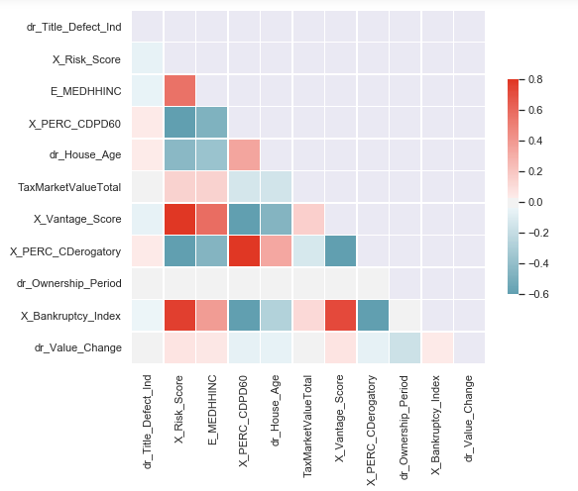
Visualization
Correlation for Title Defect
Heatmap for Correlation
Correlation | dr_Title_ Defect_Ind | X_Risk _Score | E_MEDHH INC | X_PERC _CDPD60 | dr_House _Age | TaxMarket ValueTotal
dr_Title_ Defect_Ind | 1.000 | -0.051 | -0.044 | 0.041 | 0.036 | 0.005
X_Risk _Score | -0.051 | 1.000 | 0.561 | -0.867 | -0.433 | 0.145
E_MEDHH INC | -0.044 | 0.561 | 1.000 | -0.475 | -0.364 | 0.147
X_PERC _CDPD60 | 0.041 | -0.867 | -0.475 | 1.000 | 0.349 | -0.130
dr_House _Age | 0.036 | -0.433 | -0.364 | 0.348 | 1.000 | -0.142
TaxMarket ValueTotal | 0.005 | 0.145 | 0.147 | -0.130 | -0.142 | 1.000
X_Vantage _Score | -0.050 | 0.980 | 0.583 | -0.835 | -0.457 | 0.156
X_PERC_ CDerogatory | 0.041 | -0.812 | -0.454 | 0.923 | 0.334 | -0.122
dr_Owner ship_Period | -0.022 | 0.025 | 0.007 | -0.015 | -0.024 | -0.004
X_Bank ruptcy_Index | -0.033 | 0.766 | 0.384 | -0.720 | -0.270 | 0.114
dr_Value _Change | -0.0116 | 0.063 | 0.056 | -0.060 | -0.050 | 0.025
Business & Project Overview | Methodologies | Success Criteria | Modeling | Results | Insurance Product
19

Slide 20
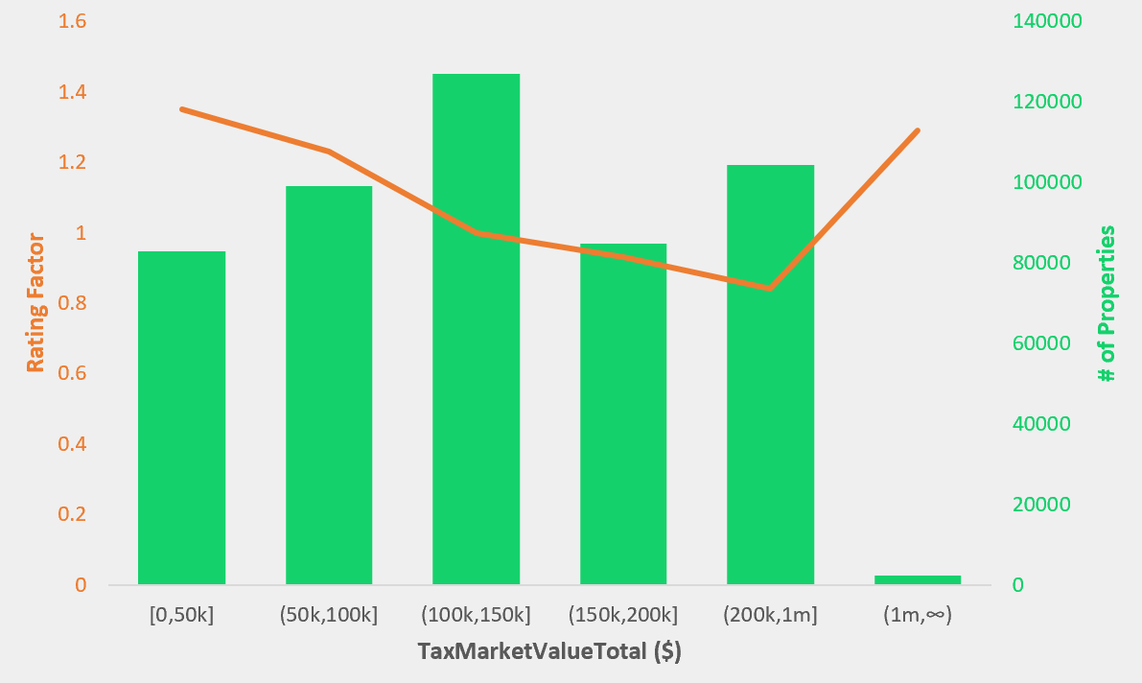
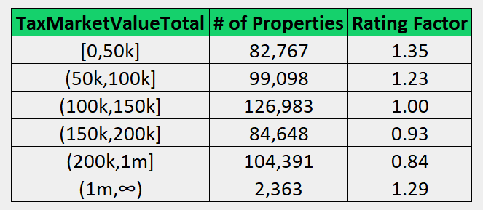
A Deeper Look Into TaxMarketValueTotal
Example: TaxMarketValueTotal (Coef: 0.0049)
Definition: Total market value of the property
Possible Drivers:
The property with high market value represents the household has considerable income which ensure the success of transaction
Findings:
Amount within 0 - 50k tend to have the highest title defect risk
From 0 to 1 million, the higher the market value, the lower the title defect risk
For the property with market value above 1 million, it turns out high risk since the extremely high amount may contains more potential risk and interrupt the transaction
Business & Project Overview | Methodologies | Success Criteria | Modeling | Results | Insurance Product
20

Slide 21
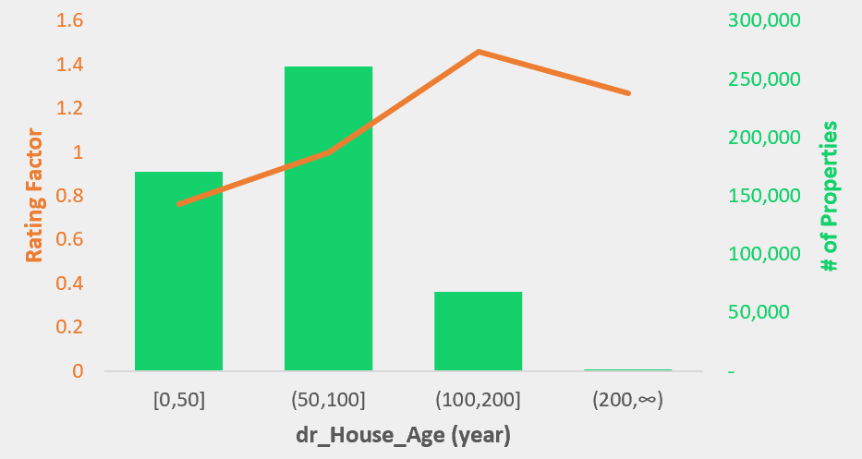
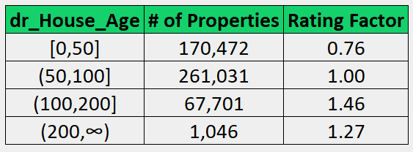
A Deeper Look Into dr_House_Age
Example: dr_House_Age (Coef: 0.0355)
Definition: Age of the house
Possible Drivers:
House’s lifetime determines house quality, the property may incur unexpected accidents as time goes by
Findings:
Years within 100 - 200 tend to have the highest title defect risk
From 0 to 200 years, the older the house, the higher the title defect risk
For the house age longer than 200 years, the risk may be lower because the lifetime is too long to consider for the transaction, and it only act as a small part of the data population
Business & Project Overview | Methodologies | Success Criteria | Modeling | Results | Insurance Product
21

Slide 22
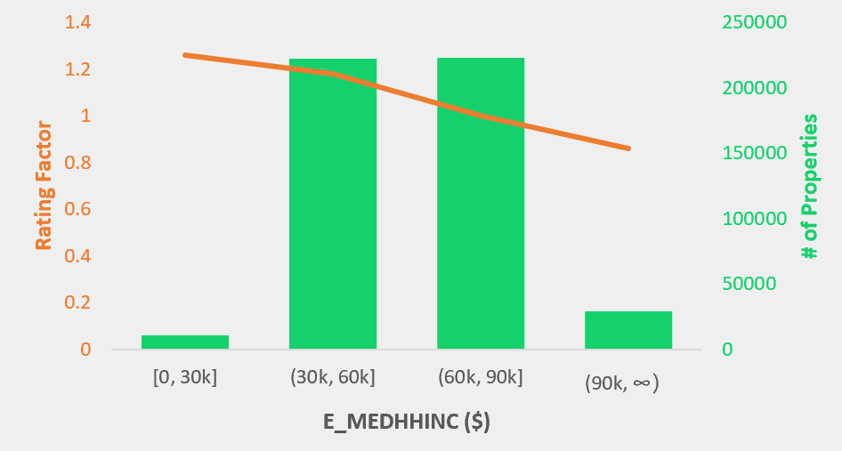
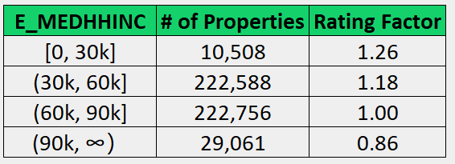
A Deeper Look Into E_MEDHHINC
Example: E_MEDHHINC (Coef: - 0.0441)
Definition: Median household Income
Possible Drivers:
Higher income generally results in lower risk of title defect as there would be less incentive to exhibit behavior that could induce a title to become dirty
Findings:
Households with income between 0-30k tend to have the highest title defect risk
The higher the income, the lower the title defect risk
Most households in the sample dataset are in mid-level income, which indicates the target customer for the company
Business & Project Overview | Methodologies | Success Criteria | Modeling | Results | Insurance Product
22

Slide 23

Recommendation
Customer
Competitor
Stakeholder
Attract customer with low title defect risks
Utilize rating factor to compute premium
Invest heavily in fintech
and data analytics
Become local market winner
Increase operational efficiency
Analyze problems on a
case-by-case basis
Business & Project Overview | Methodologies | Success Criteria | Modeling | Results | Insurance Product
23

Slide 24
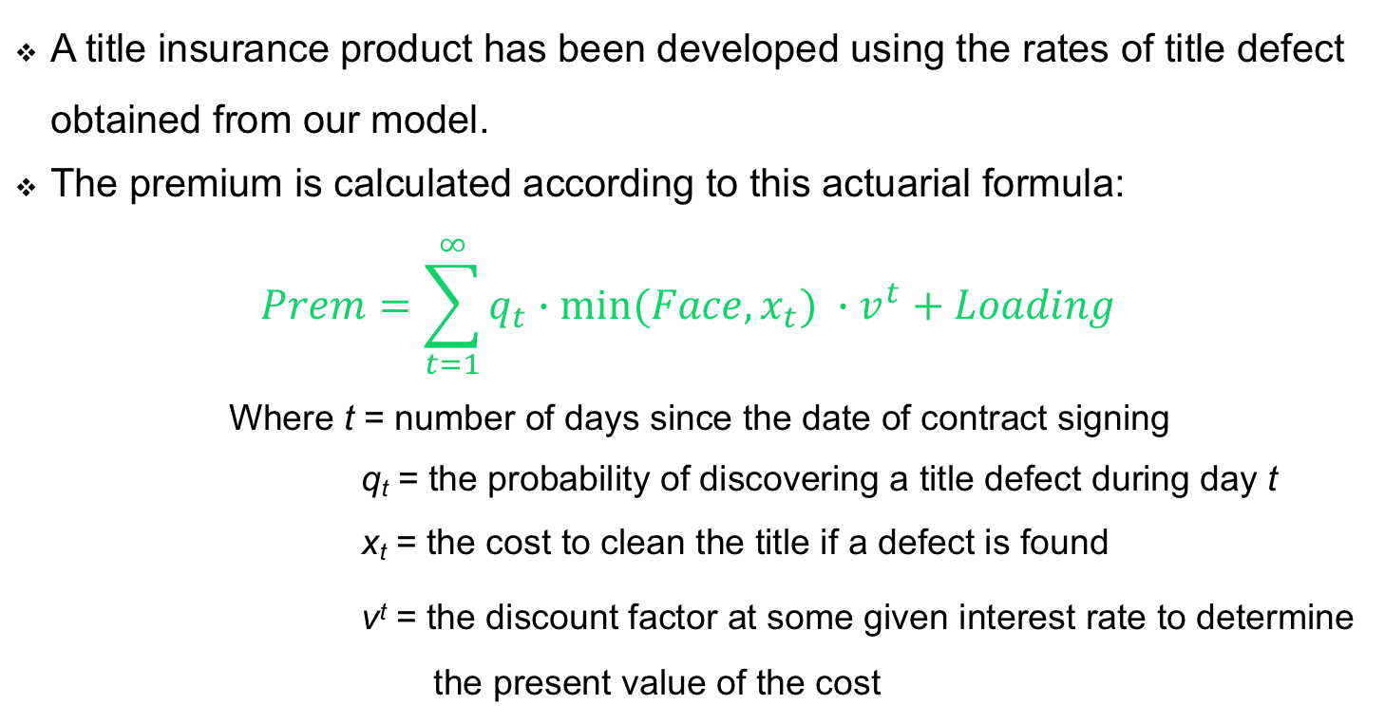
Insurance Product
A title insurance product has been developed using the rates of title defect obtained from our model.
The premium is calculated according to this actuarial formula:
$$Prem=\sum_{t=1}^{∞}{q_{t}∙{{min⁡(Face,x}_{t}) ∙v}^{t}}+Loading$$
Where t = number of days since the date of contract signing
q_{t} = the probability of discovering a title defect during day t
x_{t} = the cost to clean the title if a defect is found
v^{t} = the discount factor at some given interest rate to determine the present value of the cost
Business & Project Overview | Methodologies | Success Criteria | Modeling | Results | Insurance Product
24

Slide 25
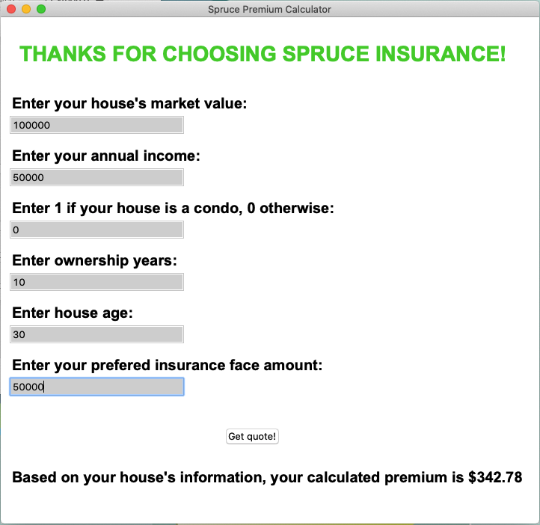

Insurance Product
Input 6 variables
Utilize rating factor
Set a minimum probability of 0.67%
Business & Project Overview | Methodologies | Success Criteria | Modeling | Results | Insurance Product
25

Slide 26
THANK YOU
PRESENTED BY
THE ALEAT RS
Fanya Weng
26

